Slide 1


Fixed Assets Operations in Oracle E-Business Suite (EBS)
Students names:
Omar Hassan
Omar Soliman
Mostafa Eltaweel
Ahmed Ramadan
Track: Oracle Digital Accounting Specialist
Supervisor name: Mohamed Sobhy
27/04/2025

Slide 2
Introduction
This project focuses on implementing the Fixed Assets module in Oracle E-Business Suite (EBS) to automate and streamline financial processes.
This will help reduce errors, improve compliance, and speed up period-end closing, making the process more efficient and reliable for organizations.

Slide 3
Fixed Assets Operations and Reporting in Oracle ERP
1- Adding New Assets
2- Managing Assets
3- Period-End Closing and Reporting

Slide 4
Adding New Assets
Adding new assets manually.
Adding new assets through mass additions.
Assets integration with the AP Module.

Slide 5
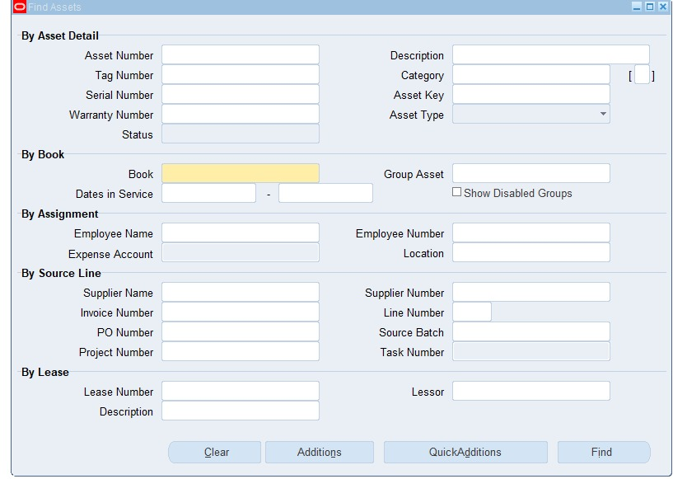
Adding new assets manually
Fixed Assets > Assets > Asset Workbench
Adding a New Asset:
You can add a new asset using two available methods:
Quick Additions: a simplified method for entering basic
asset information quickly.
Additions: a detailed method that allows full control
Over the asset data entry process.

Slide 6
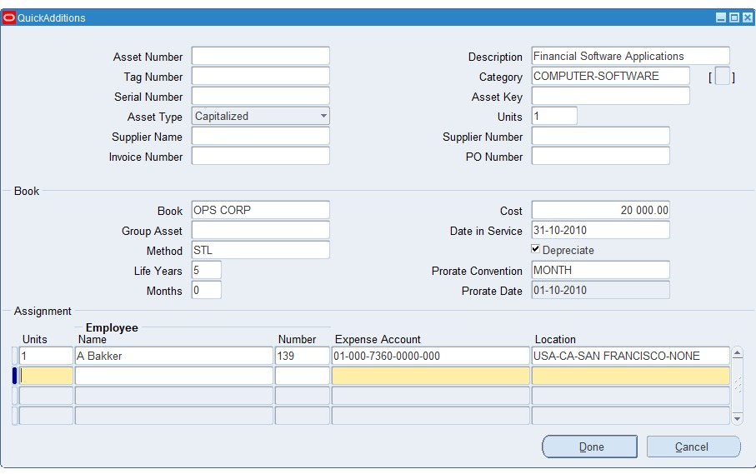
Quick Additions
The Quick Additions screen allows users
to add a new asset quickly by entering
only the essential information.
When to Use Quick Additions:
When you need to create an asset record
quickly with minimal data entry.

Slide 7
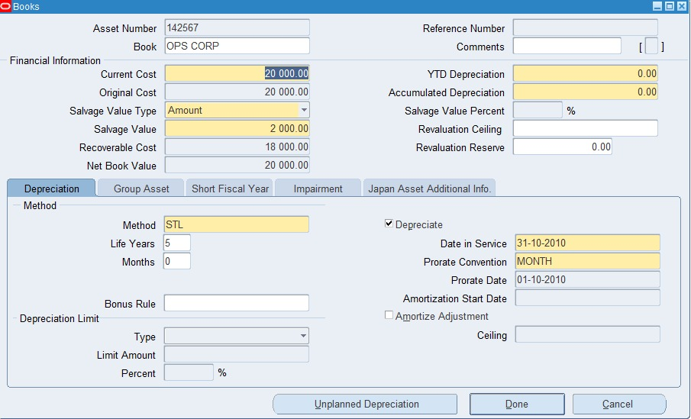
books
This screen is used to define the
financial details of an asset, especially related
to depreciation, cost.
Key Sections & Fields:
Financial Information
Depreciation Method

Slide 8
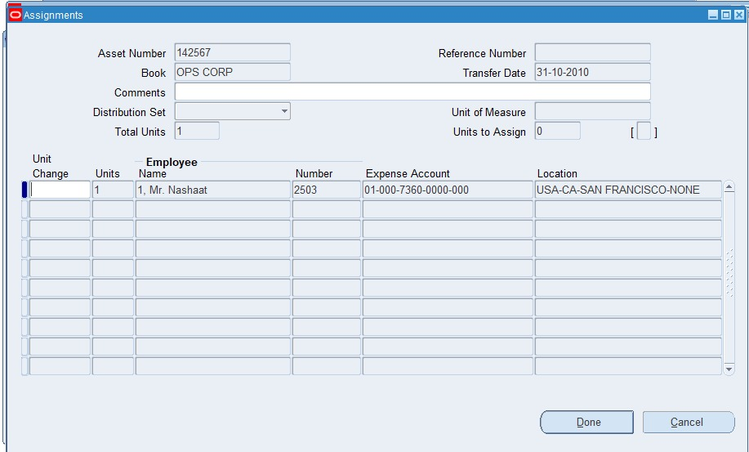
Assignments
This screen is used to assign an asset to
an employee or a location, and to track its usage and
cost center.
Key Fields:
Employee Name & Number
Expense Account
Location
Units

Slide 9
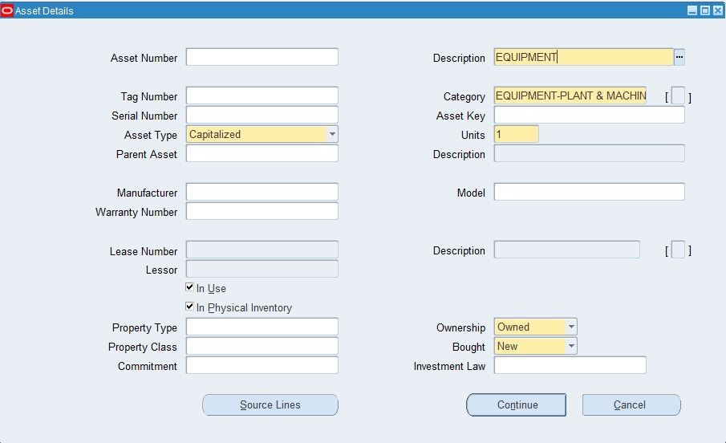
Additions
The Additions method in Oracle E-Business Suite (EBS)
It is used when an organization needs to enter an asset
With full financial and operational details.
Unlike Quick Additions, this method provides more
control and flexibility over all aspects of the asset.
Key Steps in the Additions Process:
Asset Workbench Navigation:
Path: Fixed Assets > Assets > Asset Workbench Click
The Additions button from the "Find Assets" screen.
Asset Details Entry:
Input fields like Description, Category, Asset Type, and Units.

Slide 10
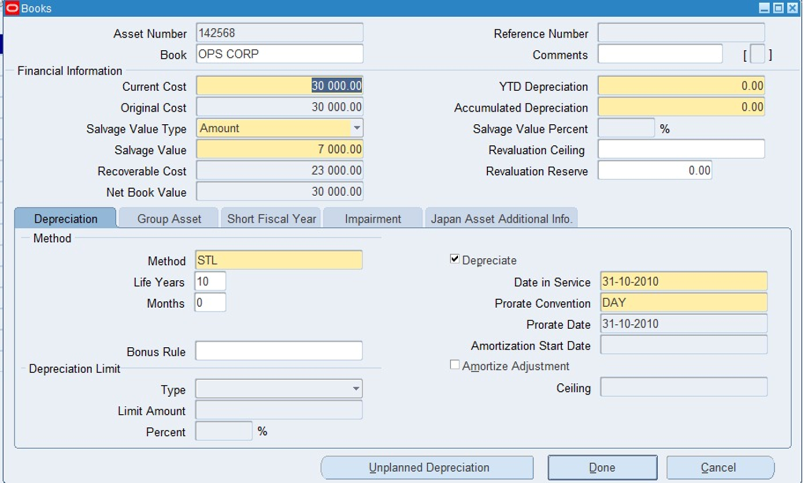
Books (within Additions)
In the Additions method, the Books screen is
where we configure all the financial settings of the
asset, especially those related to cost and depreciation.
Main Sections:
Financial Information
Depreciation Method

Slide 11
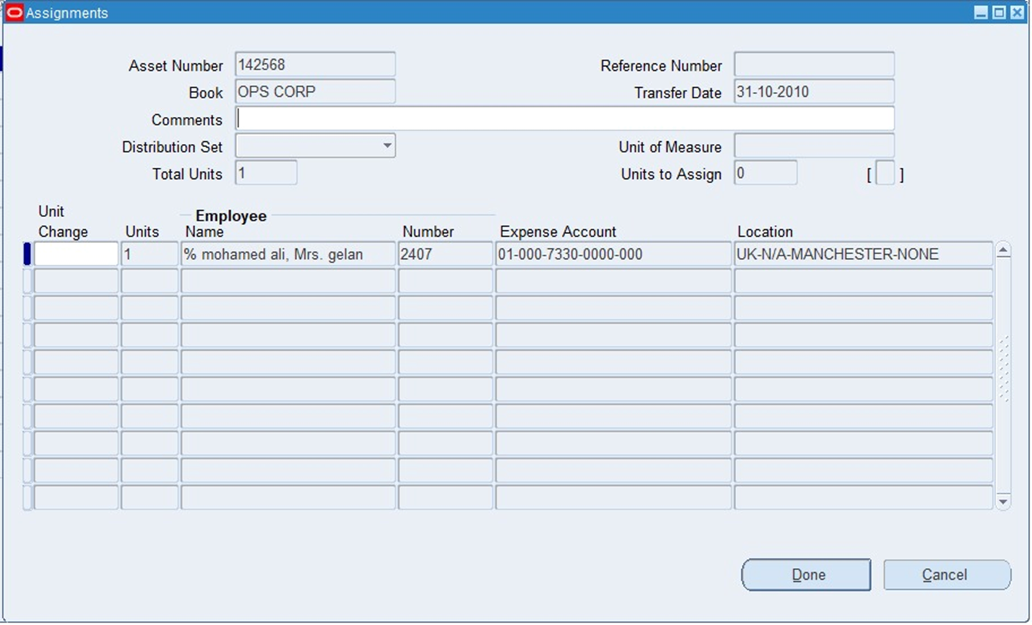
Assignments (within Additions)
In the Additions method, the Assignments screen
It is used to define who is responsible for the asset.
where the asset is located, and which cost center is
financially accountable.
Key Fields and Sections:
Employee Information
Employee Name & Number
Expense Account
Location
Units
Depreciation Expense Account

Slide 12
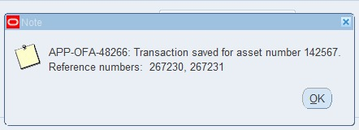
Asset Number Generation
After successfully adding a new asset, Oracle EBS automatically generates a unique Asset Number.
This Asset Number is used to track, manage, and report the asset throughout its lifecycle.
The number appears immediately after saving the asset details.
It ensures that each asset has a unique identity in the system.

Slide 13
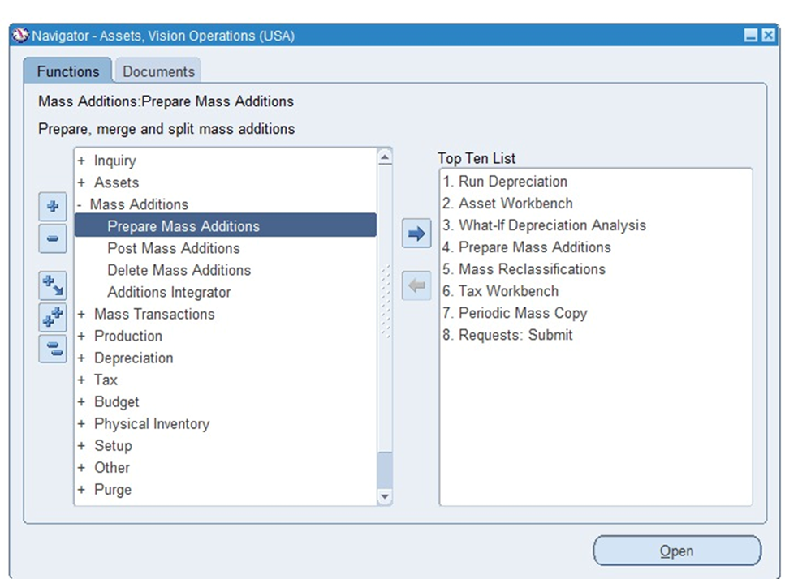
Adding new assets through mass additions
Assets typically come from external modules like Accounts
Payable.
Users can prepare the asset data before officially adding it to
The Asset Workbench.

Slide 14
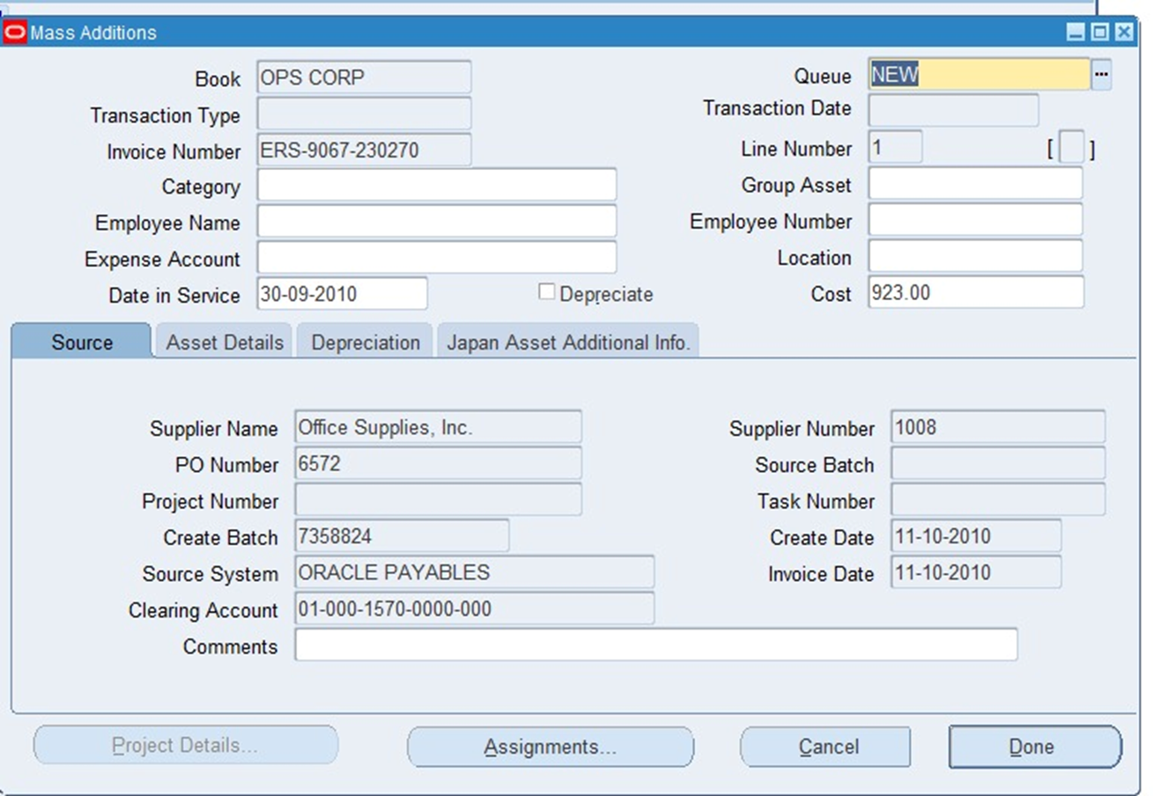
Mass Addition
This screen is used to review and edit the information
of individual mass addition lines.
Displays important fields like Book, Transaction Type,
Invoice Number, Cost, and Source Details.
Users can update the asset information before
approving and posting it into Oracle Assets.
Main Purpose:
Validate and complete the asset information before
final asset creation.

Slide 15
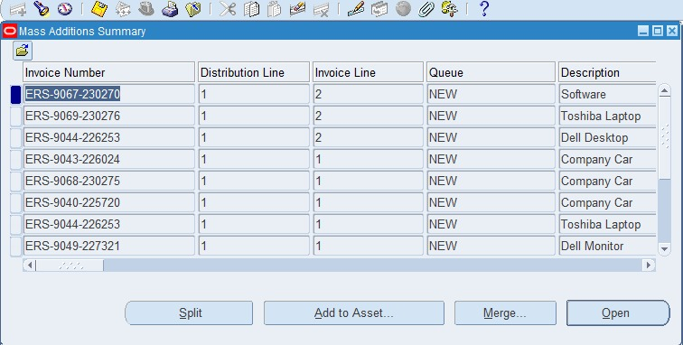
Mass Additions Summary
This screen shows a list of all assets imported from
Oracle Payables (AP) is waiting to be added.
Displays key fields:
Invoice Number, Distribution Line, Invoice Line,
Queue, Description.
Users can:
Open a specific mass addition record for review/edit.
Split a mass addition into multiple assets.
Merge multiple lines into one asset.
Add to Asset directly when ready.
Main Purpose:
Manage and process mass additions before they become fixed assets.

Slide 16
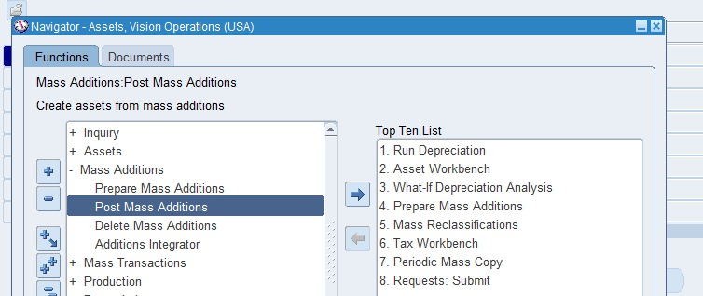
Post Mass Additions
Assets<Mass Additions<Post Mass Additions

Slide 17
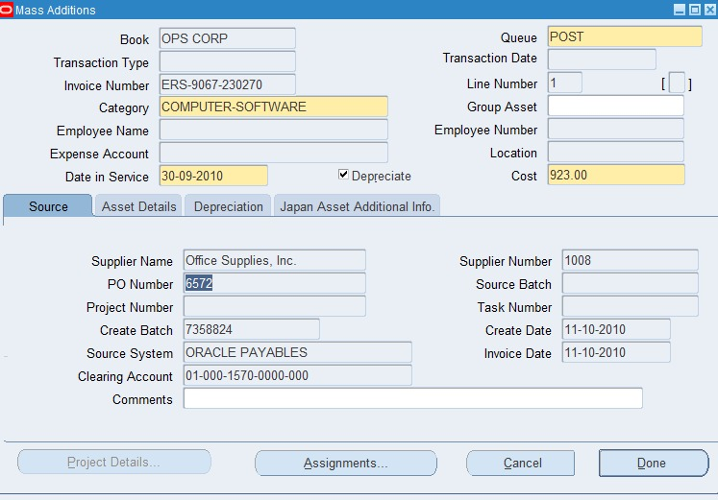
Post Mass Additions
After you prepare and review assets in the Prepare
Mass Additions screen, the next step is Post Mass
Additions.
Main Purpose:
To post (finalize) the assets into the fixed asset register.
What happens during Post?
The system moves assets from a "New" or "Ready" status into
the official asset books.

Slide 18
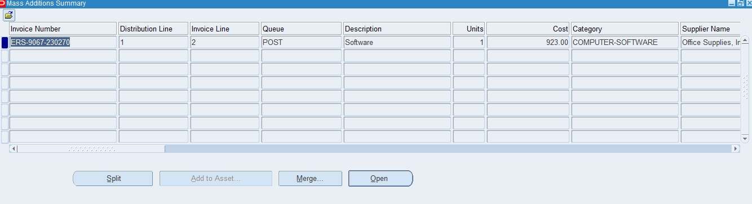
Post Mass Additions
Mass Additions summary after Posting

Slide 19
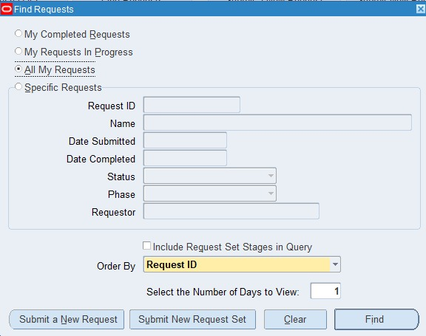
1-Mass Additions Create Report
View ➔ Requests ➔ Submit a New Request

Slide 20
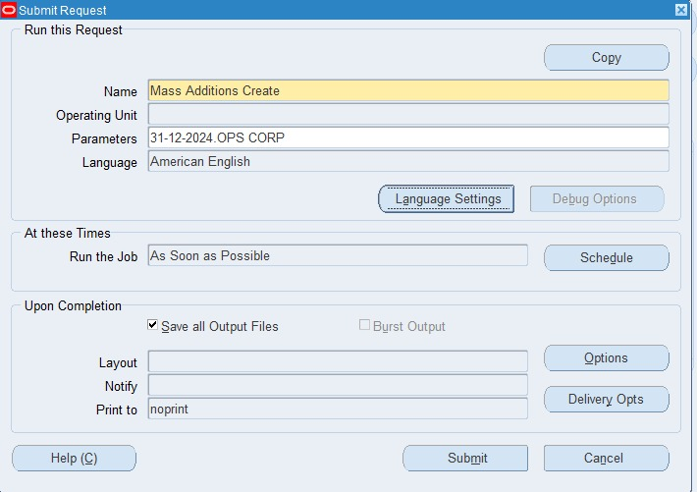
2-Mass Additions Create Report
After submitting a new request choose a name for the report.
Choose parameters and GL
Date and book asset.

Slide 21
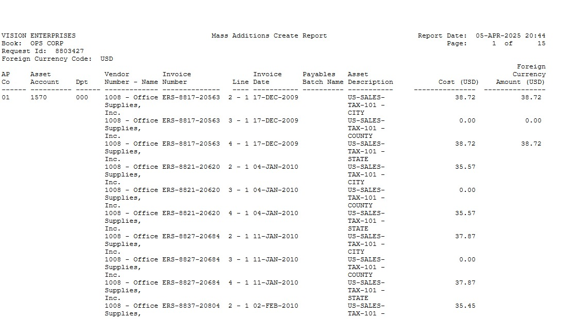
3-Mass Additions Create Report
The Mass Additions Create Report
shows all assets that were imported from the external
systems (like Oracle Payables) into Oracle Assets
But they have not yet been posted.
When do you run it?
✔ After you transfer invoices from Oracle Payables
or other sources into Oracle Assets.
✔ To review what assets have been created and are
waiting for review and posting.
What does the report show?
➔ Asset details like Invoice Number, Cost, Category, Source
System, and more.
➔ Helps you check if all imported asset data is correct
before you "Prepare" and "Post" them.

Slide 22
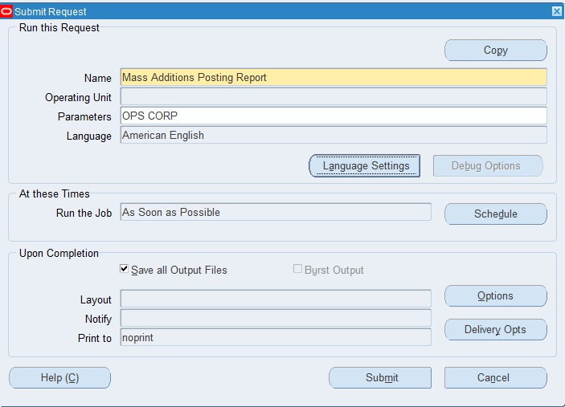
1-Mass Additions Posting Report
View ➔ Requests ➔ Submit a New Request.
After submitting a new request choose a name for the report.
Choose parameters and book an asset.
Choose Submit

Slide 23
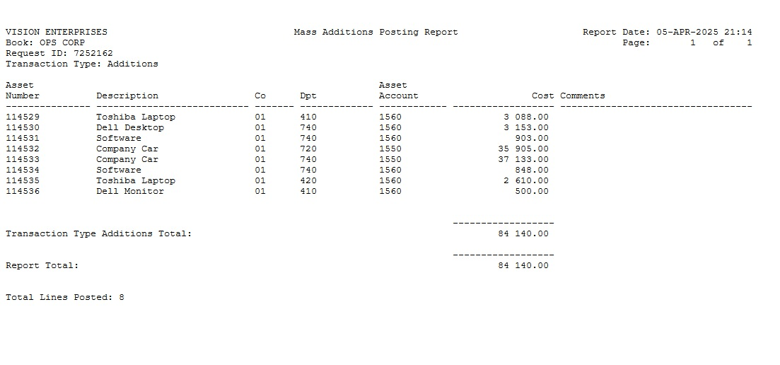
2-Mass Additions Posting Report
The Mass Additions Posting Report shows all assets
that have been successfully posted into
Oracle Assets from the mass additions queue.
When do you run it?
✔ After you complete the Post Mass Additions process.
✔ To confirm which assets have been officially added to
the asset register.
What does the report show?
Asset Number
Description
Asset Account
Cost
Book Name (OPS CORP).

Slide 24
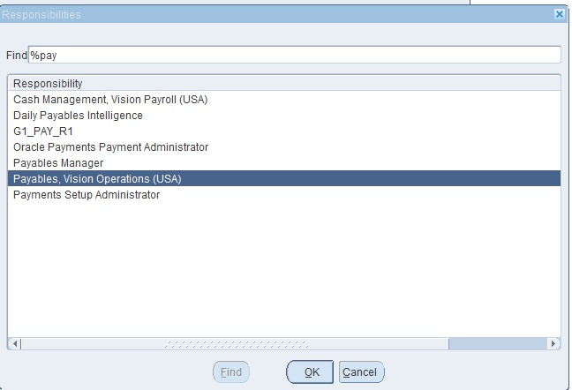
1- Assets integration with the AP Module
Click on Navigator.
Go to Responsibilities.
Select Payables Vision Operations.

Slide 25
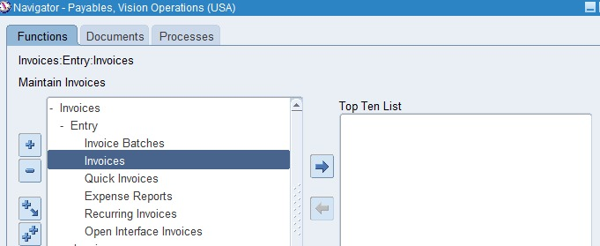
2- Assets integration with the AP Module
Invoice ➔ Entry ➔ Invoice

Slide 26
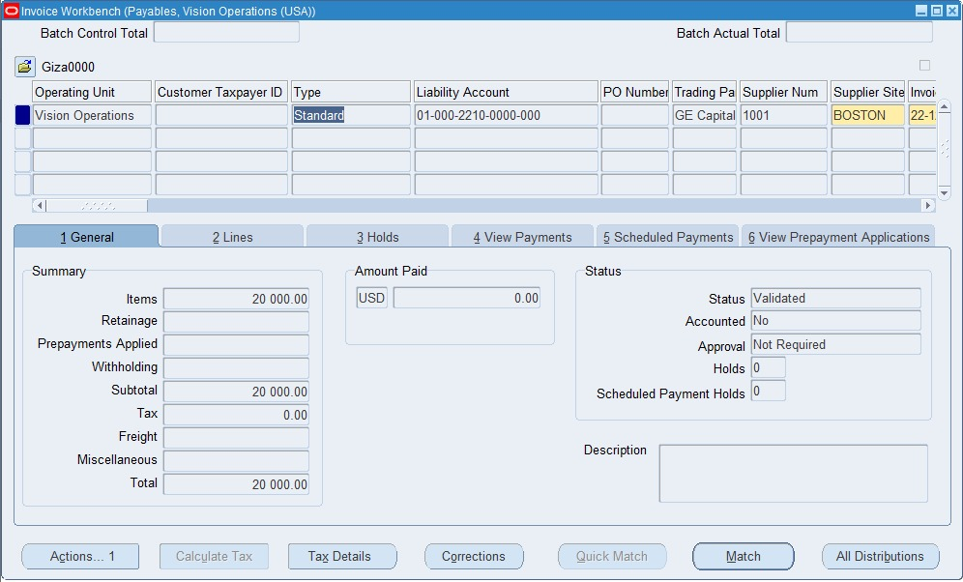
3- Assets integration with the AP Module
This screen is used to enter and manage suppliers
invoices. In your case, since you are working on
Assets integration with AP, the invoice is recorded
Here will later be used to create an asset in the
Fixed Assets module after processing.
Regarding the Assets Integration:
After the invoice is validated and accounted for in AP,
It will be transferred to Assets using a process Mass
Additions Create.
Then, in the FA module, you use Post Mass Additions
to officially create the asset.

Slide 27
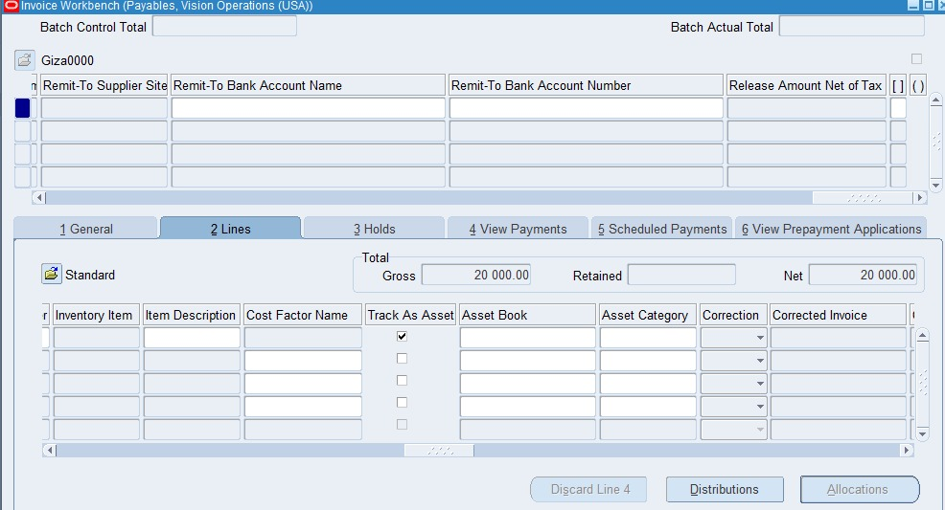
4- Assets integration with the AP Module
The Track as Asset checkbox is critical when you
want the invoice line item to be sent from Accounts
Payable (AP) to Fixed Assets (FA).
When you check Track as Asset, you are telling the system:
This invoice line should create a new Asset in the FA module.
Then, during the Mass Additions process, the system picks
up all lines that have.
Track as Asset is checked and sends them to the FA module.

Slide 28
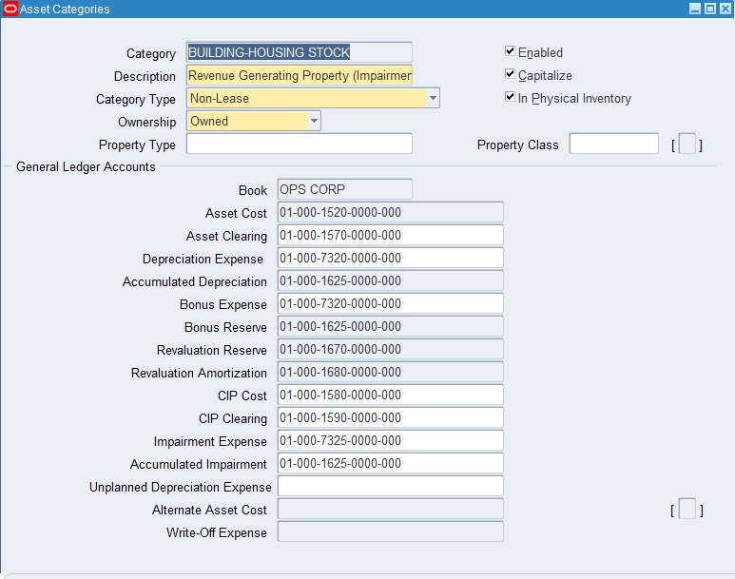
5- Assets integration with the AP Module
Steps to find the Asset Clearing Account :
Setup ➔ Asset System ➔ Asset Categories.
Open the Asset Categories screen.
Select the Asset Category you are interested in.
Scroll down to the General Ledger Accounts section.
Look for the field named (Asset Clearing).
This account is used during Mass Additions to move amounts
from AP to FA.

Slide 29
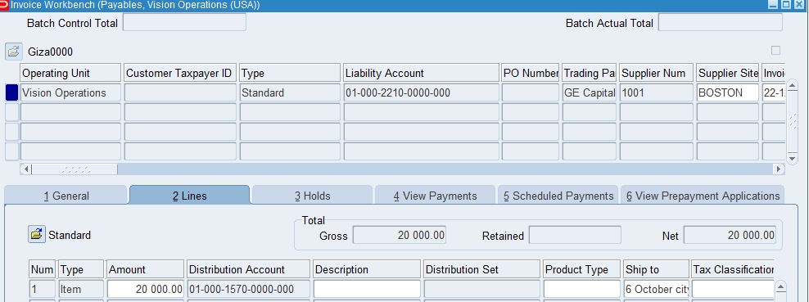
6- Assets integration with the AP Module
Instead, you temporarily post the invoice amount to an
Asset Clearing Account (an intermediate account).
Later, when the asset is created in Fixed Assets (FA),
The system moves the value from the Asset Clearing
Account to the final Asset Account.
In AP:
Invoice distribution = Asset Clearing Account.
In FA (after Mass Addition):
System moves it to the real Asset Category/Account.

Slide 30
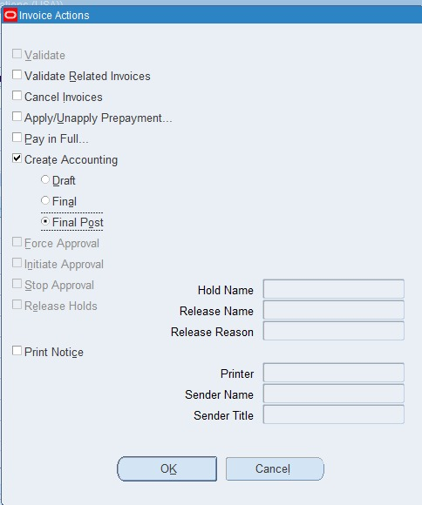
7- Assets integration with the AP Module
The last step here is: "Create Accounting" (Final Post)
You are telling the system to generate accounting entries for the invoice.
This will post the amounts (the asset clearing entry) into the
General Ledger (GL).
Create Accounting (Final Post):
Generate and permanently save the accounting for this invoice in
The system.

Slide 31
Managing Assets
Assets Details and Financial Inquiry
Assets Transfer and Adjustment
Assets Depreciation and Retirement

Slide 32
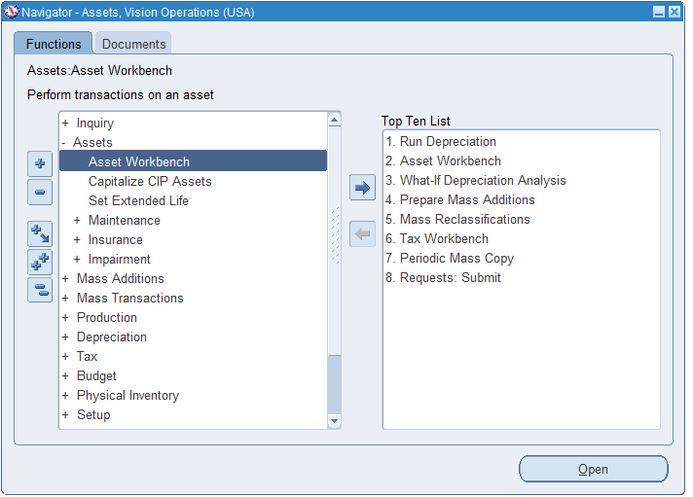

Slide 33
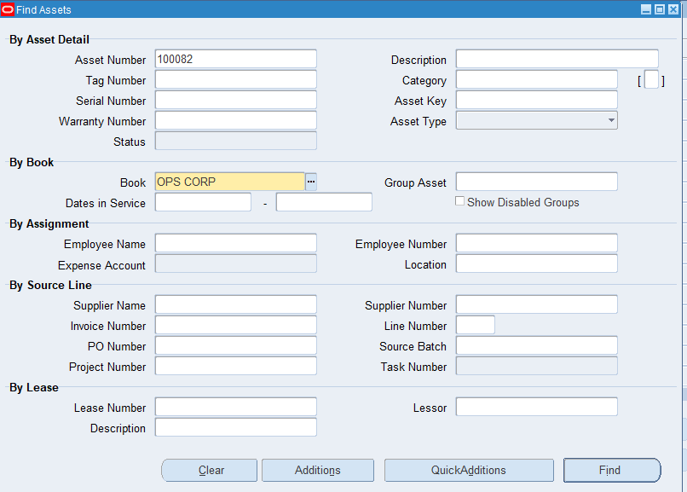
Assets Vision Operations >> Assets Workbench
Assets Workbench >> Find

Slide 34
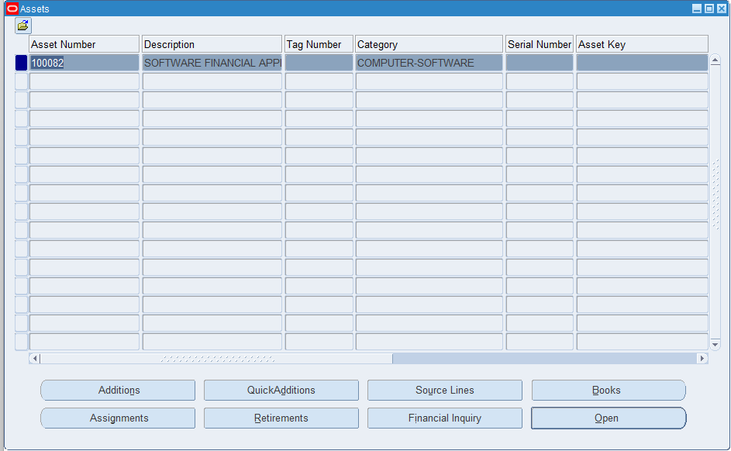
Assets Vision Operations >> Assets Workbench
Assets Workbench >> Find

Slide 35
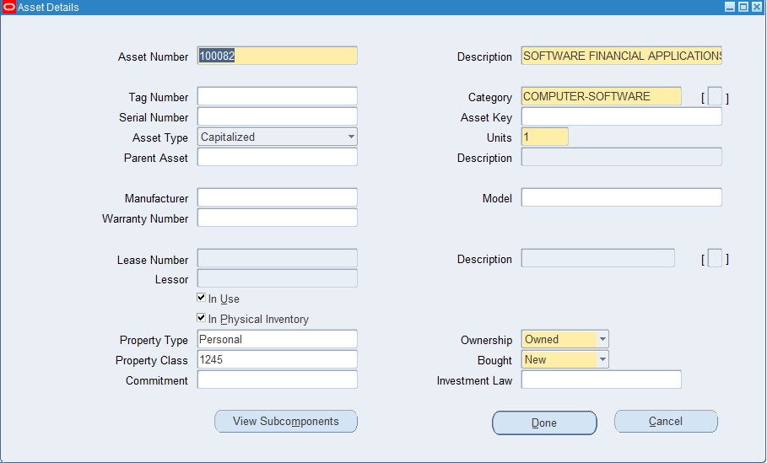
Assets Vision Operations >> Assets Workbench
Assets Workbench >> Find
Assets >> Open

Slide 36
Assets Vision Operations >> Assets Workbench
Assets Workbench >> Find

Slide 37
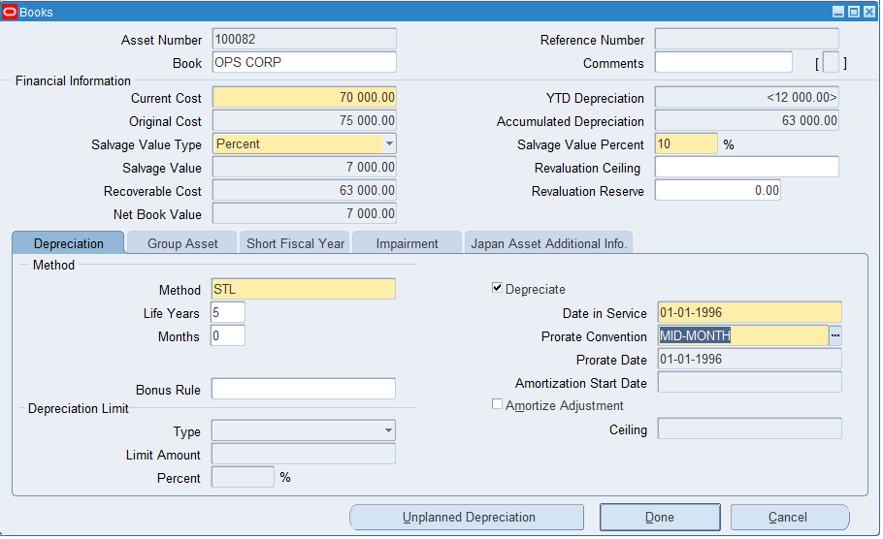
Assets Vision Operations >> Assets Workbench
Assets Workbench >> Find
Assets >> Books

Slide 38
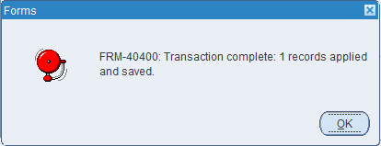
Assets Vision Operations >> Assets Workbench
Assets Workbench >> Find
Assets >> Books
Books >> Done

Slide 39
Assets Vision Operations >> Assets Workbench
Assets Workbench >> Find

Slide 40
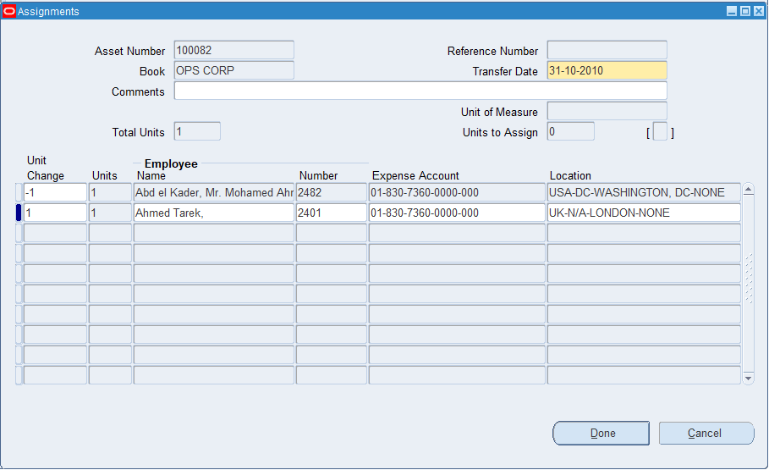
Assets Vision Operations >> Assets Workbench
Assets Workbench >> Find
Assets >> Assignments

Slide 41
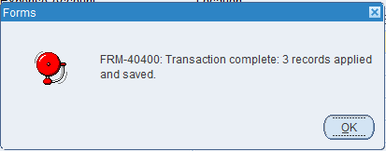
Assets Vision Operations >> Assets Workbench
Assets Workbench >> Find
Assets >> Assignments
Assignments >> Done

Slide 42
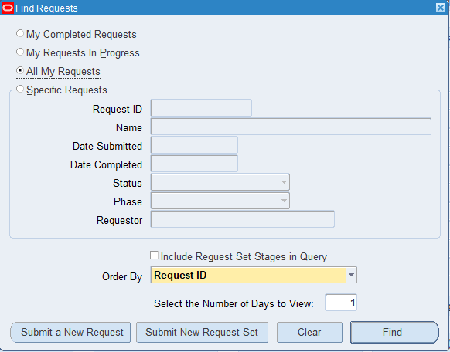
Assets Vision Operations >> View
View >> Request

Slide 43
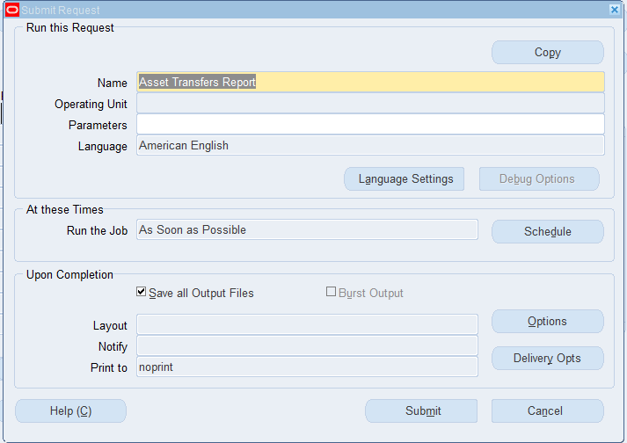
Assets Vision Operations >> View
View >> Request
Request >> Submit New Request

Slide 44
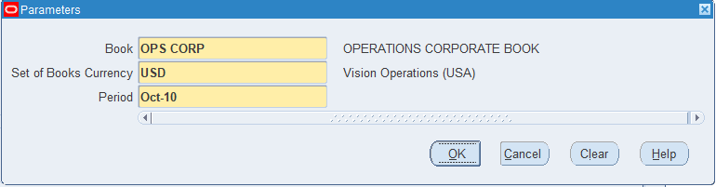
Assets Vision Operations >> View
View >> Request
Request >> Submit New Request

Slide 45
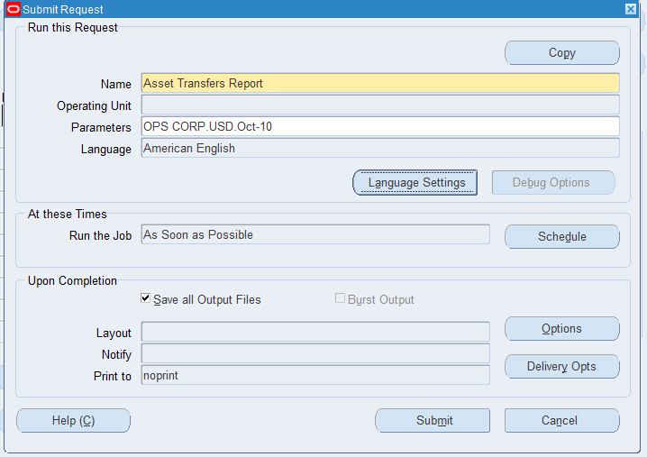
Assets Vision Operations >> View
View >> Request
Request >> Submit New Request
Submit New Request >> OK

Slide 46
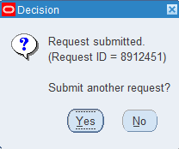
Assets Vision Operations >> View
View >> Request
Request >> Submit New Request
Submit New Request >> OK
Submit New Request >> Submit

Slide 47
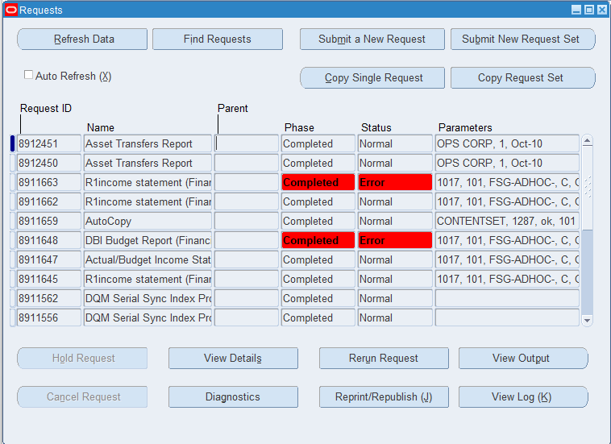
Assets Vision Operations >> View
View >> Request
Request >> View Output

Slide 48
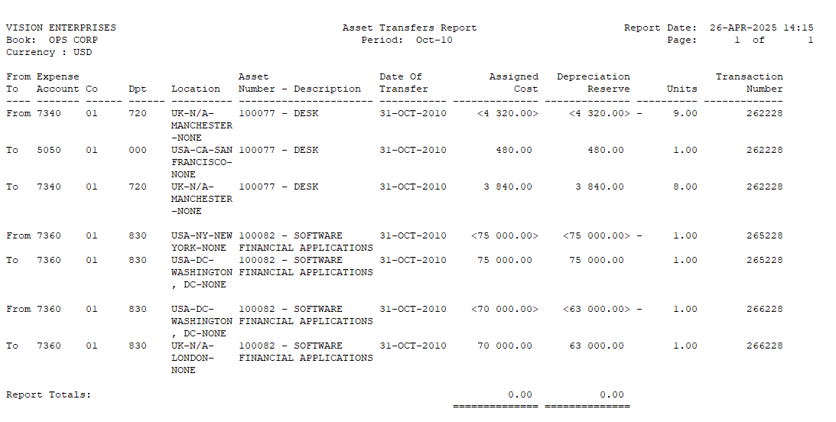
Assets Transfer Report

Slide 49
Assets Vision Operations >> Assets Workbench
Assets Workbench >> Find

Slide 50
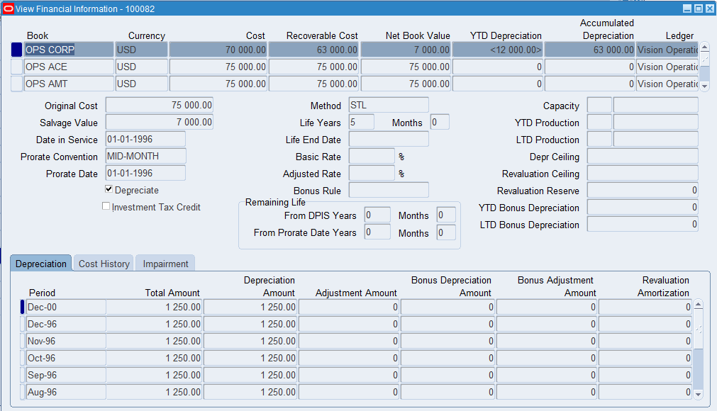
Assets Vision Operations >> Assets Workbench
Assets Workbench >> Find
Assets >> Financial Inqiury

Slide 52
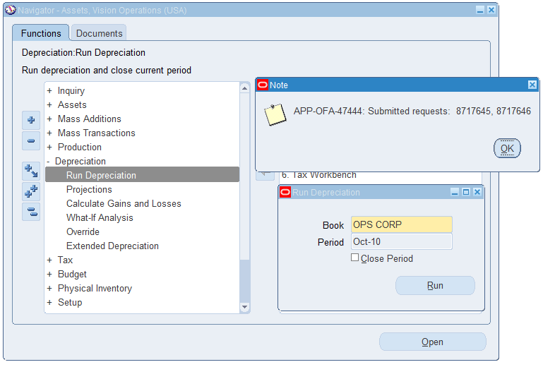
Assets Vision Operations >>
Depreciation >> Run Depreciation
Run Depreciation >> Run

Slide 53
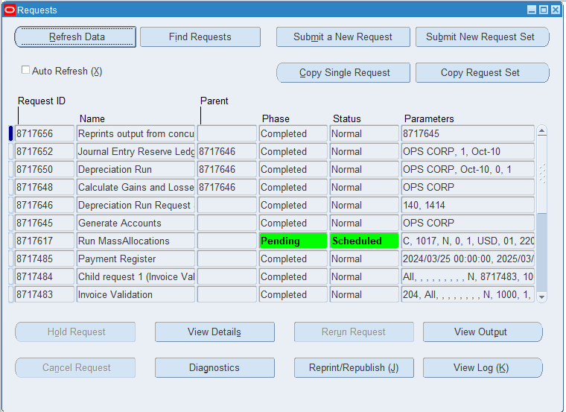
From the top menu bar >> View >> Requests

Slide 54
Final assset
Manage Retirement to assets
Reconciled with the General Ledger

Slide 55
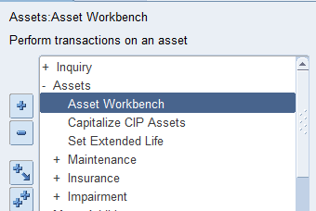
manage retirements
Assets >>asset workbench

Slide 56
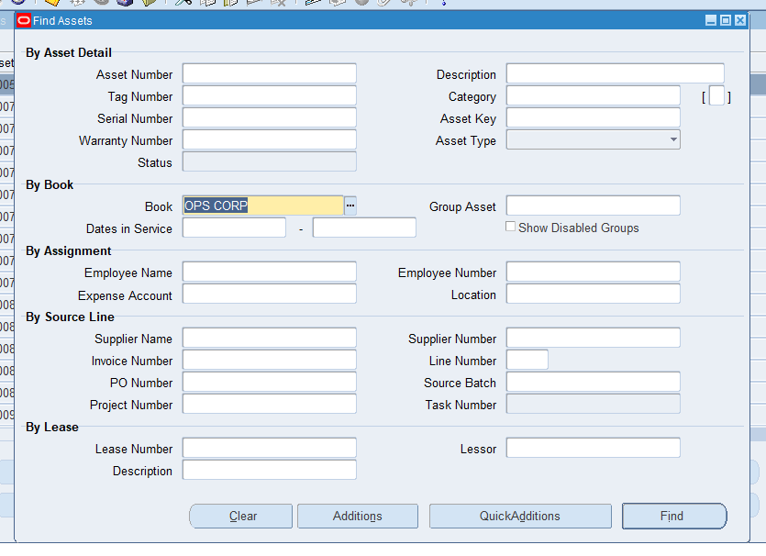
Serch by book
Ops corp > find

Slide 57
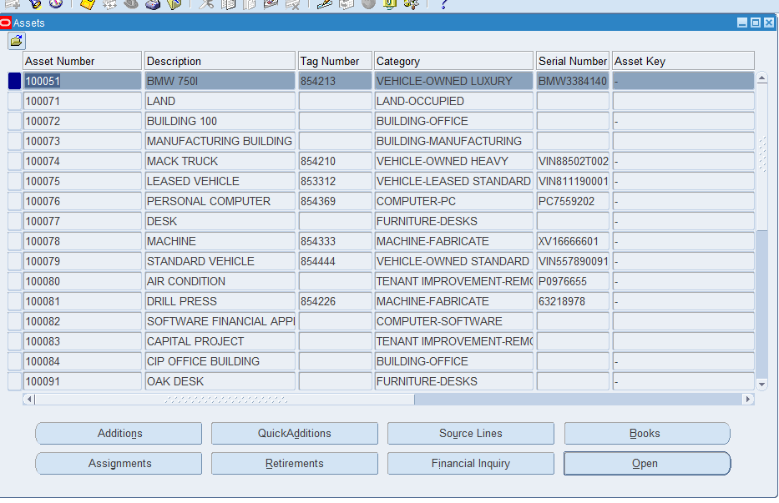

Slide 58
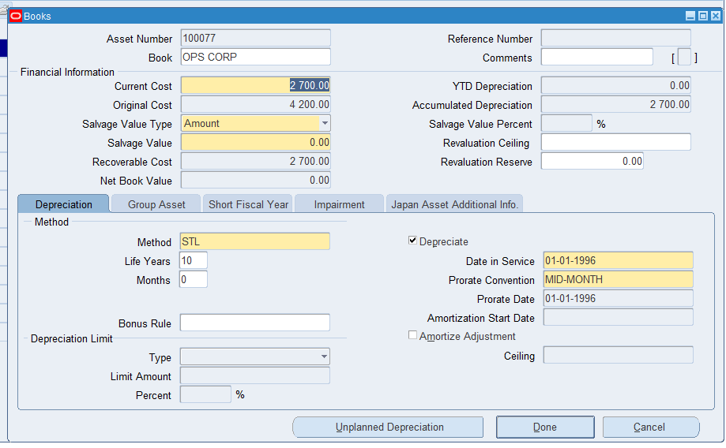
Chose book
We chose the number of asset 100077 to see the current cost to make the retirement ,and see if the asset use for another retirement cicle or not (original cost )

Slide 59
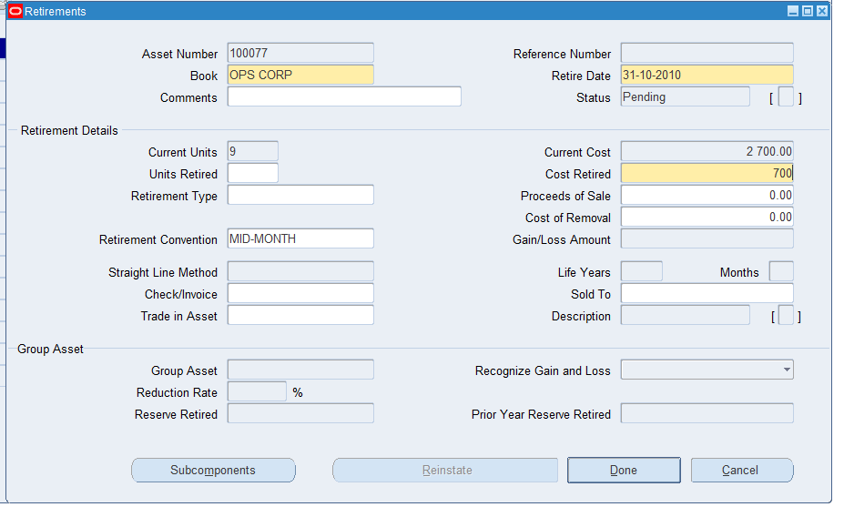
Chose retirement box
You can retired the asset with unit , with cost

Slide 60
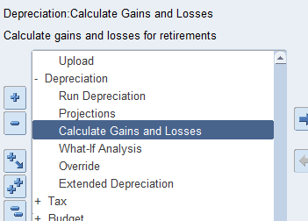
We go to calculate gain &loss
Depreciations > calculate gain and loss

Slide 61


To see output go to
View > requests

Slide 62


See output

Slide 63



View > requests > submit a new request
Criate request
Asset retirements report

Slide 64

View output

Slide 65


Slide 66

Final we can sending our transactions to the general ledger use
Create accounting

Slide 67



Slide 68


Slide 69


Slide 70
Thank you for your attention.
We now invite any questions or feedback from you.

